Slide 1

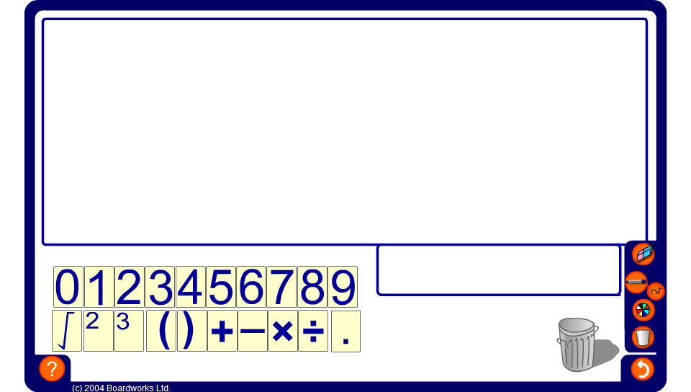


Target numbers
Notes:
Give pupils 4 digits, for example, 2, 4, 5 and 8 and challenge them to make a target number (for these digits we could have 70) using all four digits and any of the given operations.
Allow pupils a few moments to jot down their answers and then ask a volunteer to demonstrate their solution on the board by dragging the required cards into the large box.
For example, 8 × (4 + 5) – 2. The solution 70 will appear in the small box.
Some target numbers may have several solutions using the required digits. If other pupils have an alternative solution invite them to demonstrate it on the board.
Other examples (with the target number shown in bold):
(7 + 8) × 2 – 5 = 25
(1 + 2 + 3)² + 4 = 40
(3 + 7) ÷ (1 + 4) = 2
√(6 + 7 + 8 – 5) = 4
2 × 7² + 5 – 3 = 100

